Slide 1
Analytics for a Better World Recitation 3

Slide 2
Schedule
Homework
Quick Topic Review
Working through an application

Slide 3
Homework
Homework 1 feedback and solutions are out
Everyone was able to get correct optimal solutions
Some folks had issues with their drawings. Gradients would point in the wrong direction. (Often the second gradient was in the opposite direction of the first when it should have been perpendicular). By looking at the geometry you should be able to tell these gradients would lead to a different optimal solution than the one computed with software.
Homework 2 is released
Focuses on modeling and coding for two problems
Vaccination clinic location
Radiotherapy treatment
Due Feb 28th

Slide 4
Topic Review
Past Week:
Lecture 6 HDR Brachytherapy Treatment
Lecture 5 Cattle Feed for Small Farmers
Earlier:
Lecture 4 Integer Optimization
Lecture 3 World Food Programme
Lecture 2 Linear Optimization
Lecture 1 Introduction

Slide 5
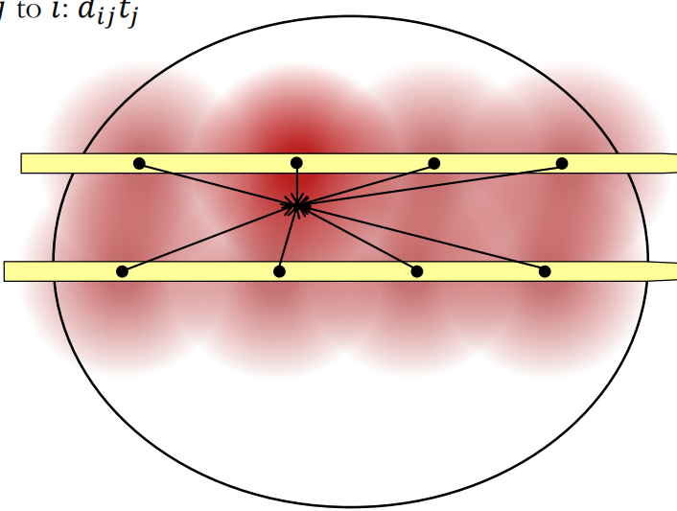
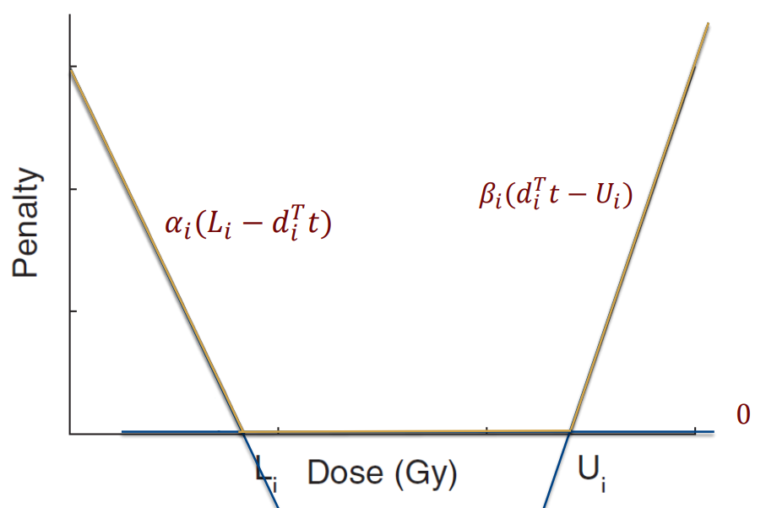
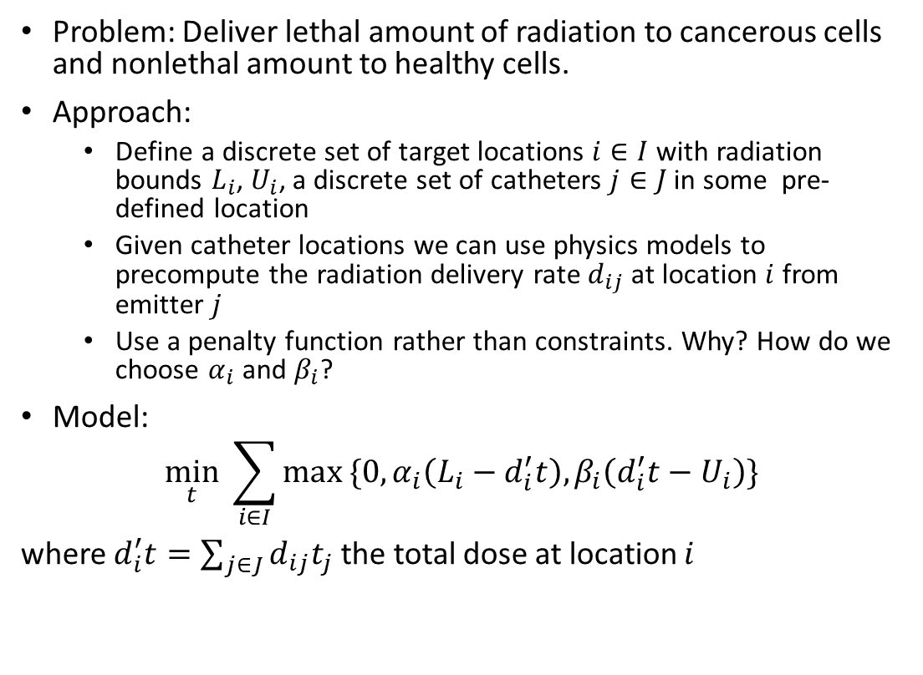
Lecture 6 HDR Brachytherapy Treatment
Problem: Deliver lethal amount of radiation to cancerous cells and nonlethal amount to healthy cells.
Approach:
Define a discrete set of target locations $i∈I$ with radiation bounds $L_{i}$, $U_{i}$, a discrete set of catheters $j∈J$ in some pre-defined location
Given catheter locations we can use physics models to precompute the radiation delivery rate $d_{ij}$ at location $i$ from emitter $j$
Use a penalty function rather than constraints. Why? How do we choose $α_{i}$ and $β_{i}$?
Model:
$$\min_{t} \sum_{i∈I}{max \{0,α_{i}\left(L_{i}−d_{i}^{′}t\right),β_{i}\left(d_{i}^{′}t−U_{i}\right)\} }$$
where $d_{i}^{′}t=\sum_{j∈J}{d_{ij}t_{j}}$ the total dose at location $i$

Slide 6
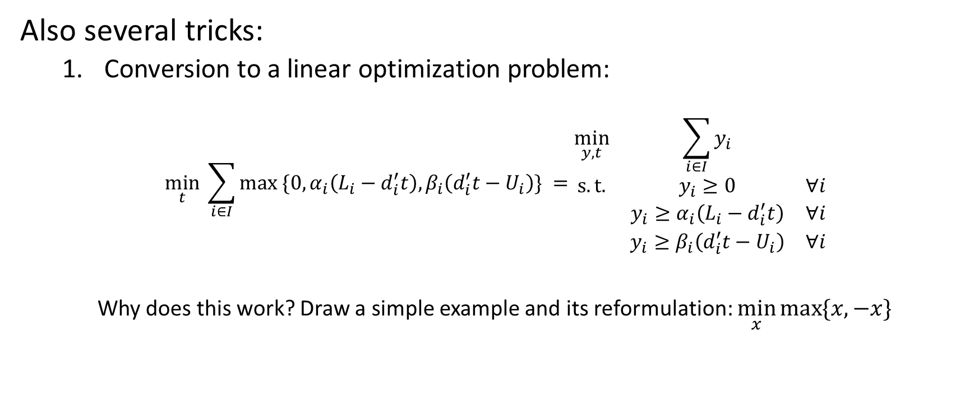
Lecture 6 HDR Brachytherapy Treatment cont.
Also several tricks:
Conversion to a linear optimization problem:
$$\min_{t} \sum_{i∈I}{max \{0,α_{i}\left(L_{i}−d_{i}^{′}t\right),β_{i}\left(d_{i}^{′}t−U_{i}\right)\} }=\begin{matrix}\min_{y,t} & \sum_{i∈I}{y_{i}} & \\ s.t. & y_{i}≥0 & ∀i \\ & y_{i}≥α_{i}\left(L_{i}−d_{i}^{′}t\right) & ∀i \\ & {y_{i}≥β}_{i}\left(d_{i}^{′}t−U_{i}\right) & ∀i\end{matrix}$$
Why does this work? Draw a simple example and its reformulation: $\min_{x}{\max{\{x,−x\}}}$
In general, this is conversion of optimizing a piecewise-linear convex objective function with linear constraints to linear optimization problem.

Slide 7

Lecture 6 HDR Brachytherapy Treatment cont.
Also several tricks:
Optimizing catheter positions (less than N used):
Define $z_{j}=\left\{\begin{matrix}1 & \text{if} \text{catheter} j \text{is} \text{used} \\ 0 & \text{if} \text{catheter} j \text{is} \text{not} \text{used}\end{matrix}\right.$
$$\begin{matrix}\min_{y,t,z∈{\left\{0,1\right\}}^{\left|J\right|}} & \sum_{i∈I}{y_{i}} & \\ s.t. & y_{i}≥0 & ∀i \\ & y_{i}≥α_{i}\left(L_{i}−d_{i}^{′}t\right) & ∀i \\ & {y_{i}≥β}_{i}\left(d_{i}^{′}t−U_{i}\right) & ∀i \\ & \sum_{j∈J}{z_{j}}≤N & \\ & t_{j}≤Mz_{j} & ∀j\end{matrix}$$
In general, this is picking less than N objects.

Slide 8

Lecture 6 HDR Brachytherapy Treatment cont.
Also several tricks:
Optimizing catheter positions (no neighbors):
Define $z_{j}=\left\{\begin{matrix}1 & \text{if} \text{catheter} j \text{is} \text{used} \\ 0 & \text{if} \text{catheter} j \text{is} \text{not} \text{used}\end{matrix}\right.$
$$\begin{matrix}\min_{y,t,z∈{\left\{0,1\right\}}^{\left|J\right|}} & \sum_{i∈I}{y_{i}} & \\ s.t. & y_{i}≥0 & ∀i \\ & y_{i}≥α_{i}\left(L_{i}−d_{i}^{′}t\right) & ∀i \\ & {y_{i}≥β}_{i}\left(d_{i}^{′}t−U_{i}\right) & ∀i \\ & z_{i}+z_{k}≤1 & ∀i,k \text{nbhrs} \\ & {\text{t}}_{\text{j}}\text{≤}\text{M}{\text{z}}_{\text{j}} & \text{∀}\text{j}\end{matrix}$$
Ratio of maximal to minimal dose
In general, this is an “or” constraint.

Slide 9

Lecture 6 HDR Brachytherapy Treatment cont.
Also several tricks:
Doses to locations shouldn’t differ too much:
$$\begin{matrix}\min_{y,t} & \sum_{i∈I}{y_{i}} & \\ s.t. & y_{i}≥0 & ∀i \\ & y_{i}≥α_{i}\left(L_{i}−d_{i}^{′}t\right) & ∀i \\ & {y_{i}≥β}_{i}\left(d_{i}^{′}t−U_{i}\right) & ∀i \\ & d_{i}^{′}t−d_{k}^{′}t≤B & ∀i,k\end{matrix}$$
In general, this is a reformulation of an absolute value constraint.

Slide 10

Lecture 6 HDR Brachytherapy Treatment cont.
Also several tricks:
Dwelling times should be multiples of 0.1 [s]:
Define $τ=10t$
$$\begin{matrix}\min_{y,τ∈ℤ^{\left|J\right|}} & \sum_{i∈I}{y_{i}} & \\ s.t. & y_{i}≥0 & ∀i \\ & y_{i}≥α_{i}\left(L_{i}−d_{i}^{′}\left(\frac{τ}{10}\right)\right) & ∀i \\ & {y_{i}≥β}_{i}\left(d_{i}^{′}\left(\frac{τ}{10}\right)−U_{i}\right) & ∀i \\ & & \end{matrix}$$
In general, this is an “integer-like” constraint.

Slide 11

Lecture 6 HDR Brachytherapy Treatment cont.
Also several tricks:
Max dose to min dose ratio bound:
$$\begin{matrix}\min_{y,t} & \sum_{i∈I}{y_{i}} & \\ s.t. & y_{i}≥0 & ∀i \\ & y_{i}≥α_{i}\left(L_{i}−d_{i}^{′}t\right) & ∀i \\ & {y_{i}≥β}_{i}\left(d_{i}^{′}t−U_{i}\right) & ∀i \\ & M≥d_{i}^{′}t & ∀i \\ & m≤d_{i}^{′}t & ∀i \\ & M/m≤K & \end{matrix}$$
Be careful! Why wouldn’t this work if we flipped the inequality direction?

Slide 12

Lecture 6 HDR Brachytherapy Treatment cont.
Also several tricks:
Max dose to min dose ratio bound version 2:
$$\begin{matrix}\min_{y,t} & \sum_{i∈I}{y_{i}} & \\ s.t. & y_{i}≥0 & ∀i \\ & y_{i}≥α_{i}\left(L_{i}−d_{i}^{′}t\right) & ∀i \\ & {y_{i}≥β}_{i}\left(d_{i}^{′}t−U_{i}\right) & ∀i \\ & d_{i}^{′}t≤{Kd}_{k}^{′}t & ∀i,k\end{matrix}$$

Slide 13

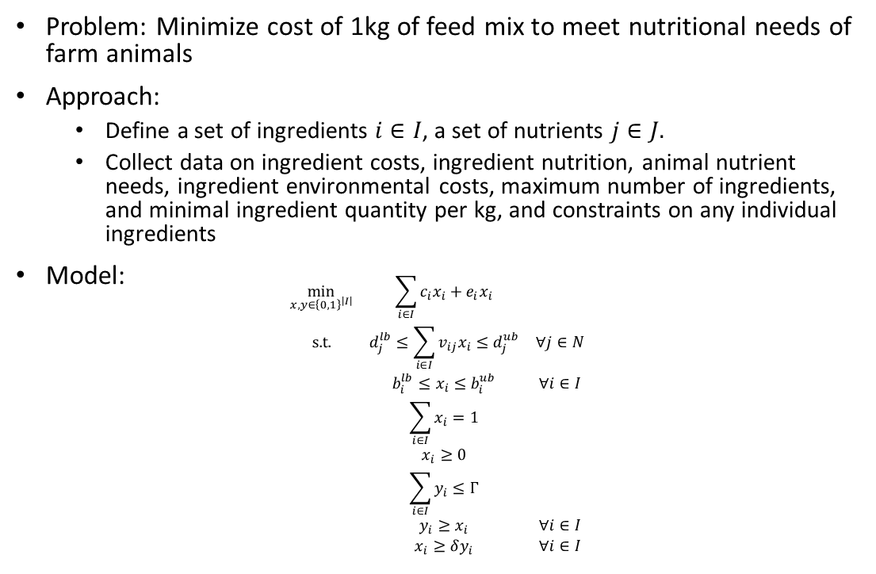
Lecture 5 Cattle Feed for Small Farmers
Problem: Minimize cost of 1kg of feed mix to meet nutritional needs of farm animals
Approach:
Define a set of ingredients $i∈I$, a set of nutrients $j∈J.$
Collect data on ingredient costs, ingredient nutrition, animal nutrient needs, ingredient environmental costs, maximum number of ingredients, and minimal ingredient quantity per kg, and constraints on any individual ingredients
Model:
$$\begin{matrix}\min_{x,y∈{\left\{0,1\right\}}^{\left|I\right|}} & \sum_{i∈I}{c_{i}x_{i}+e_{i}x_{i}} & \\ \text{s}\text{.}\text{t}\text{.} & d_{j}^{lb}≤\sum_{i∈I}{v_{ij}x_{i}≤d_{j}^{ub}} & ∀j∈N \\ & b_{i}^{lb}≤x_{i}≤b_{i}^{ub} & ∀i∈I \\ & \sum_{i∈I}{x_{i}=1} & \\ & x_{i}≥0 & \\ & \sum_{i∈I}{y_{i}}≤Γ & \\ & y_{i}≥x_{i} & ∀i∈I \\ & x_{i}≥δy_{i} & ∀i∈I\end{matrix}$$

Slide 14

Working through an application
We will implement the brachytherapy with no neighbors problem in the attached Jupyter notebook:
$$\begin{matrix}\min_{y,t≥0,z∈{\left\{0,1\right\}}^{\left|J\right|}} & \sum_{i∈I}{y_{i}} & \\ s.t. & y_{i}≥0 & ∀i \\ & y_{i}≥α_{i}\left(L_{i}−d_{i}^{′}t\right) & ∀i \\ & {y_{i}≥β}_{i}\left(d_{i}^{′}t−U_{i}\right) & ∀i \\ & z_{j}+z_{k}≤1 & ∀j,k \text{nbhrs} \\ & {\text{t}}_{\text{j}}\text{≤}\text{M}{\text{z}}_{\text{j}} & \text{∀}\text{j} \\ & \sum_{j∈J}{z_{j}}≤N & \end{matrix}$$

